Slide 1
Class 4
BUS 696
Prof. Jonathan Hersh

Slide 2
BUS 696: Class 4 Outline
Pset 2 solutions
Problem Sets
Must submit code output (regression tables and plots) along with code for full credit
Must compile Rmarkdown documents
Questions?

Slide 3
BUS 696: Class 4 Outline
Everything Correlates: https://twitter.com/businessinsider/status/1173794704506400773?s=20
HBR AI Article
Transforming X and Y variables (Feature Transformation)
Dummy Variable Interpretation (Qualitative Predictors)
Interpreting and Generating Nonlinearity in X variables (Squared Terms)
Generating Predictions and Residuals from Fitted Models
Potential Problems (Regression Diagnostics)

Slide 4

Everything Correlates
https://twitter.com/businessinsider/status/1173794704506400773?s=20

Slide 5
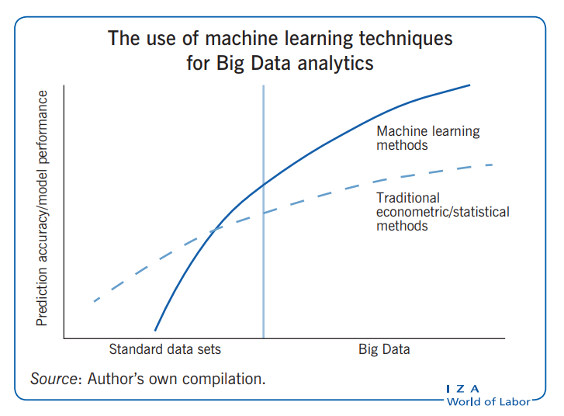

Slide 6



Slide 7
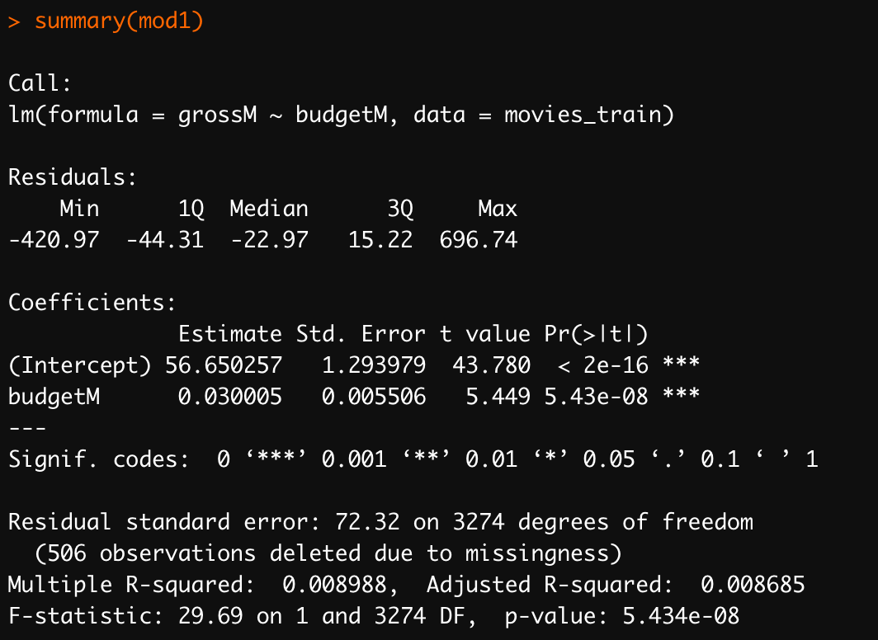
Interpreting Regression Output

Slide 8
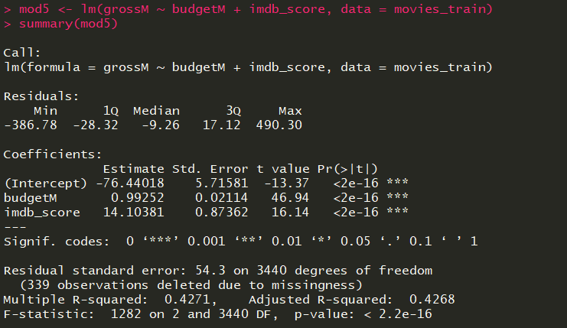
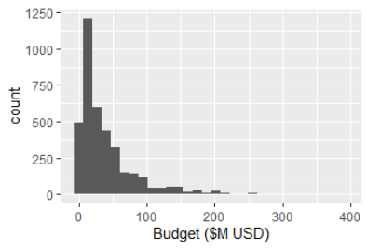
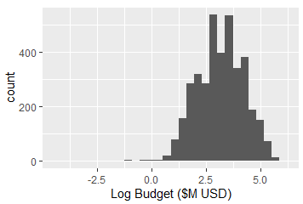
Transforming X Variables: (Feature Selection)

Slide 9
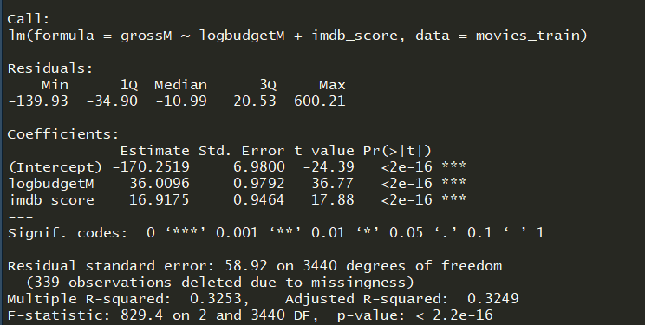
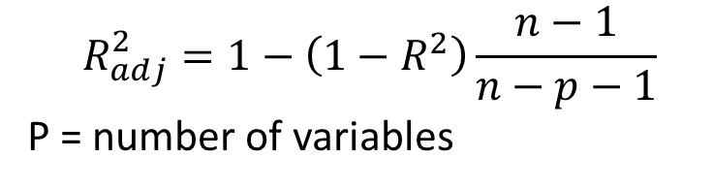
Log Budget VS Budget?
So Which Variable to Use??!
Factors to Consider
Adjusted R-Squared (higher better)
Out of sample error (in test set)
Intrepretability of Variable
$$R_{adj}^{2}=1−\left(1−R^{2}\right)\frac{n−1}{n−p−1}$$
P = number of variables

Slide 10
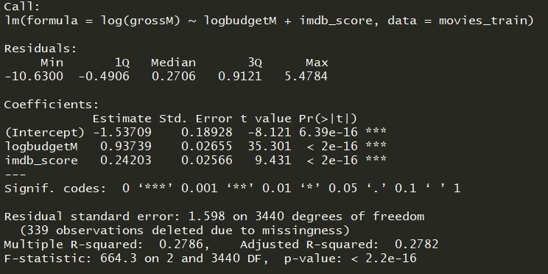

Transforming Outcome Variable: Log Transform
Log-log coefficients (logbudgetM) have a special interpretation
Can be interpreted as elasticities
E.g. 1% change in log(X) leads to a coefficient % change in Y

Slide 11
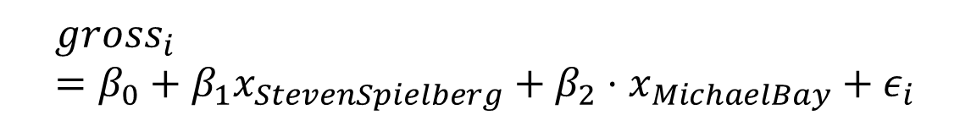
Factor: Switches, Continuous: Sliders
$$gross_{i}=β_{0}+β_{1}x_{budget}+β_{2}⋅x_{imdb_score}+ε_{i}$$
$$gross_{i}=β_{0}+β_{1}x_{StevenSpielberg}+β_{2}⋅x_{MichaelBay}+ε_{i}$$
Source: https://twitter.com/andrewheiss/status/1171084259660107777?s=20

Slide 12
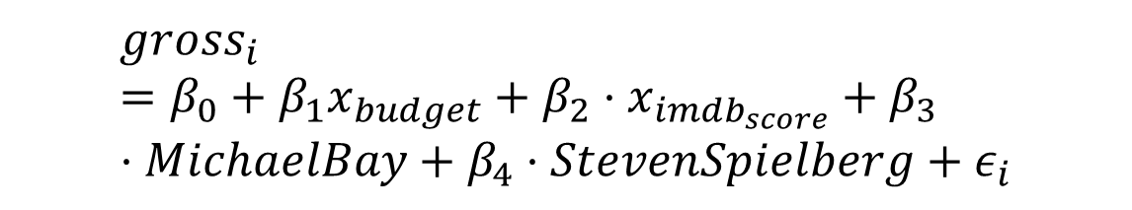
Factor: Switches, Continuous: Sliders
$$gross_{i}=β_{0}+β_{1}x_{budget}+β_{2}⋅x_{imdb_score}+ε_{i}$$
$$gross_{i}=β_{0}+β_{1}x_{budget}+β_{2}⋅x_{imdb_{score}}+β_{3}⋅MichaelBay+β_{4}⋅StevenSpielberg+ε_{i}$$
Source: https://twitter.com/andrewheiss/status/1171084259660107777?s=20

Slide 13
“Base” Levels and Factors: Data Frame
Intercept | Y | x1 | x2
1 | 0.4 | 1 | “A”
1 | -0.5 | 2 | “B”
1 | -0.3 | 3 | “B”
1 | 0.1 | 4 | “A”
1 | -0.8 | 5 | “C”

Slide 14
model.matrix(): From Factors to Dummy Variables
Intercept | Y | x1 | x2_A | X2_B
1 | 0.4 | 1 | 1 | 0
1 | -0.5 | 2 | 0 | 1
1 | -0.3 | 3 | 0 | 1
1 | 0.1 | 4 | 1 | 0
1 | -0.8 | 5 | 0 | 0
x2
“A”
“B”
“B”
“A”
“C”

Slide 15
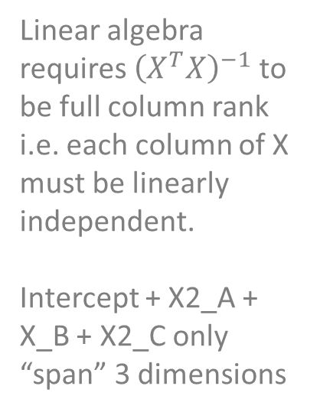
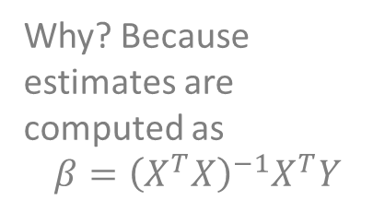
Why Does Every Factor Level Not Get Its Own Dummy Variable?
Why? Because estimates are computed as
$$β={\left(X^{T}X\right)}^{−1}X^{T}Y$$
Intercept | Y | x1 | x2_A | X2_B | X2_C
1 | 0.4 | 1 | 1 | 0 | 0
1 | -0.5 | 2 | 0 | 1 | 0
1 | -0.3 | 3 | 0 | 1 | 0
1 | 0.1 | 4 | 1 | 0 | 0
1 | -0.8 | 5 | 0 | 0 | 1
x2
“A”
“B”
“B”
“A”
“C”
Linear algebra requires ${\left(X^{T}X\right)}^{−1}$ to be full column rank i.e. each column of X must be linearly independent.
Intercept + X2_A + X_B + X2_C only “span” 3 dimensions

Slide 16
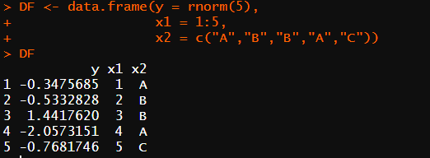
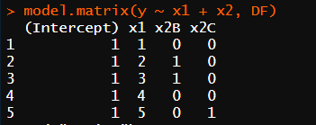
Including Qualitative Predictors (Dummy Variables)
Every qualitative predictor (factor) has been transformed into a column of binary information corresponding to that factor level

Slide 17
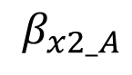
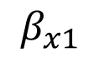
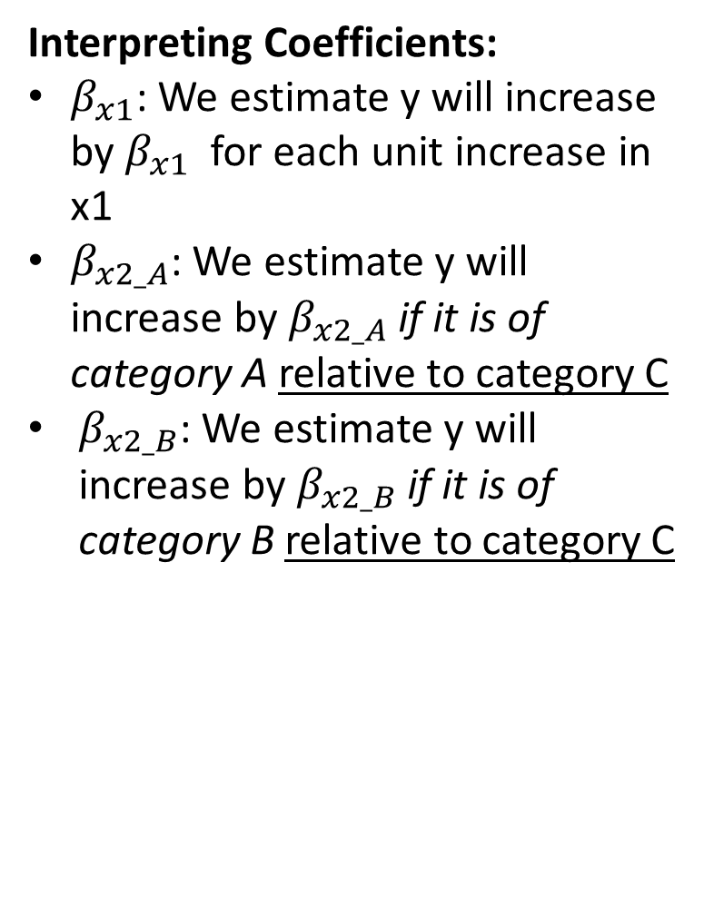
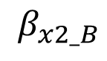
Excluded Base Level of Factor Becomes Base Level for Interpretation
$$β_{x1}$$
$$β_{x2_A}$$
$$β_{x2_B}$$
Intercept | Y | x1 | x2_A | X2_B
1 | 0.4 | 1 | 1 | 0
1 | -0.5 | 2 | 0 | 1
1 | -0.3 | 3 | 0 | 1
1 | 0.1 | 4 | 1 | 0
1 | -0.8 | 5 | 0 | 0
Interpreting Coefficients:
$β_{x1}$: We estimate y will increase by $β_{x1}$ for each unit increase in x1
$β_{x2_A}$: We estimate y will increase by $β_{x2_A}$ if it is of category A relative to category C
$β_{x2_B}$: We estimate y will increase by $β_{x2_B}$ if it is of category B relative to category C

Slide 18
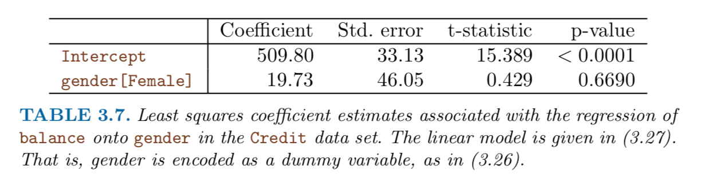
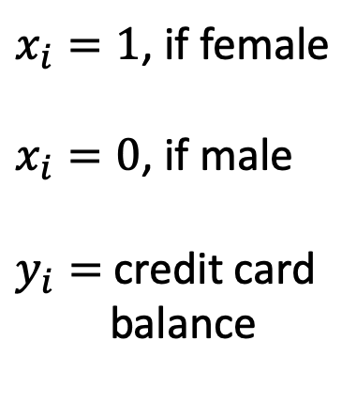
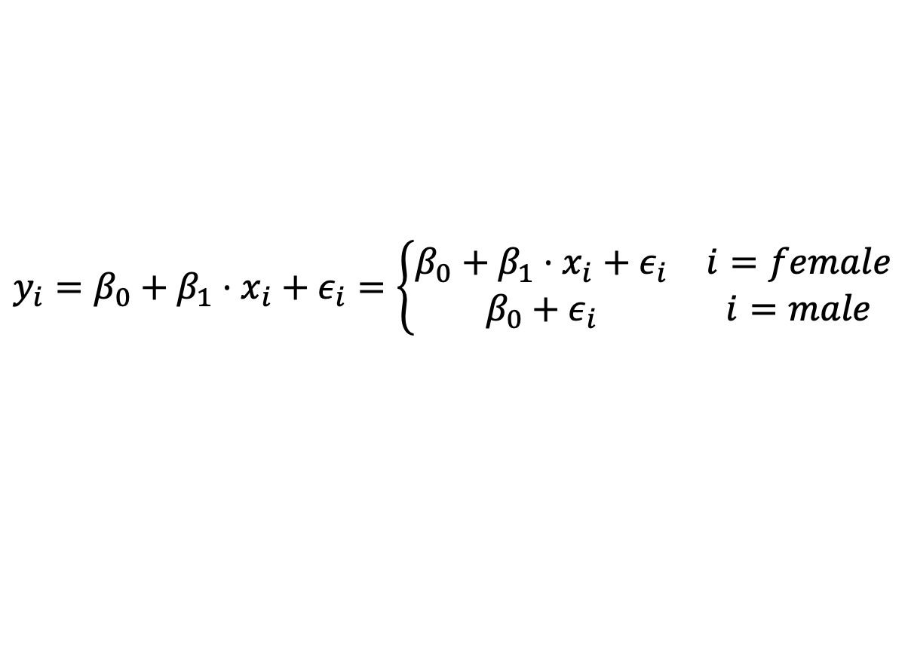
Interpreting Gender Dummy Variable Coefficients
$x_{i}=1$, if female
$x_{i}=0$, if male
$y_{i}=$ credit card
balance
$$y_{i}=β_{0}+β_{1}⋅x_{i}+ε_{i}=\left\{\begin{matrix}β_{0}+β_{1}⋅x_{i}+ε_{i} & i=female \\ β_{0}+ε_{i} & i=male\end{matrix}\right.$$

Slide 19
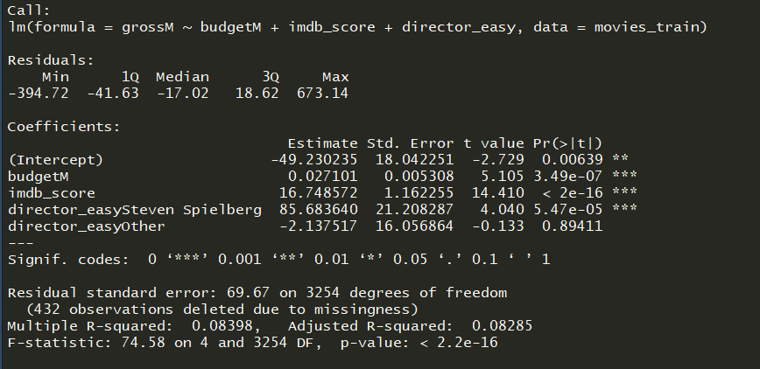
Interpreting Binary/Dummy Coefficients With Movie Data

Slide 20
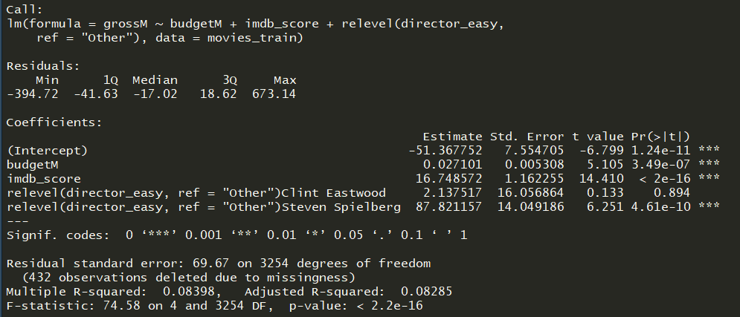
“Re-leveling” Base of Factor with relevel()

Slide 21
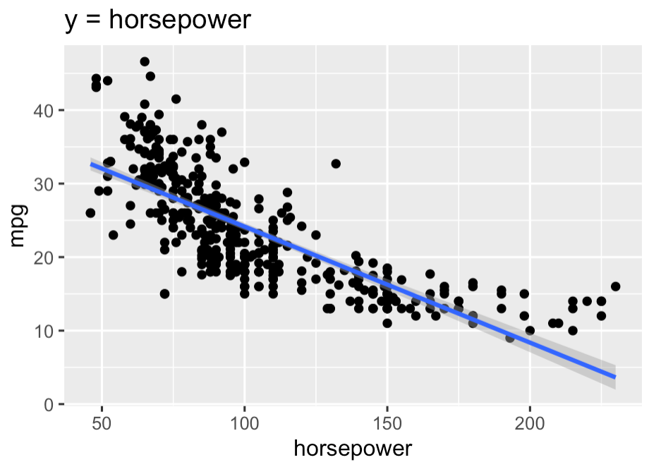
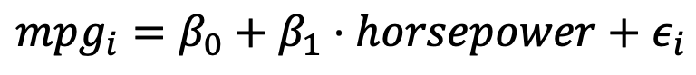
Nonlinear (Squared) Predictors
$$mpg_{i}=β_{0}+β_{1}⋅horsepower+ε_{i}$$

Slide 22
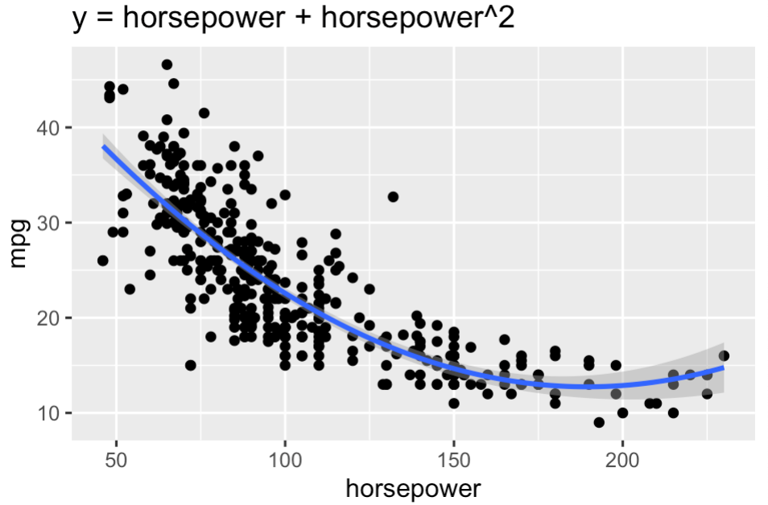
Nonlinear (Squared) Predictors
$$mpg_{i}=β_{0}+β_{1}⋅horsepower+ε_{i}$$
$$mpg_{i}=β_{0}+β_{1}⋅horsepower+β_{2}⋅horsepower^{2}+ε_{i}$$

Slide 23
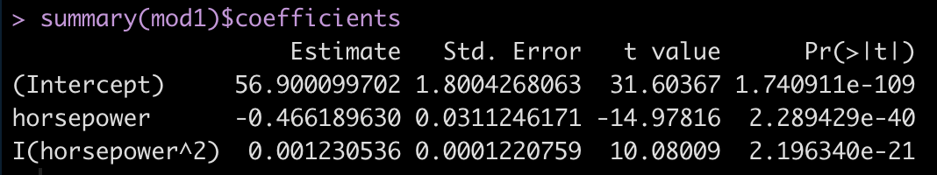
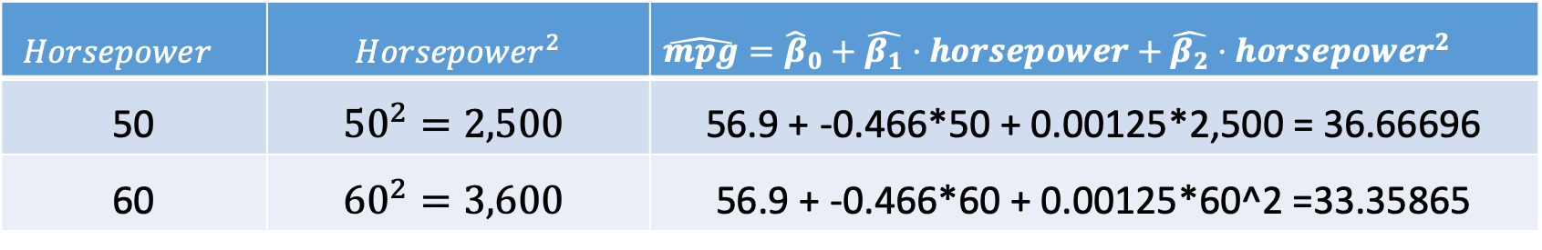
Nonlinear (Squared) Predictors
$$mpg_{i}=β_{0}+β_{1}⋅horsepower+β_{2}⋅horsepower^{2}+ε_{i}$$
$$Horsepower^{}$$ | $$Horsepower^{2}$$ | $\hat{mpg}={\hat{β}}_{0}+\hat{β_{1}}⋅horsepower+\hat{β_{2}}⋅horsepower^{2}$
50 | $${50}^{2}=2,500$$ | 56.9 + -0.466*50 + 0.00125*2,500 = 36.66696
60 | $${60}^{2}=3,600$$ | 56.9 + -0.466*60 + 0.00125*60^2 =33.35865

Slide 24
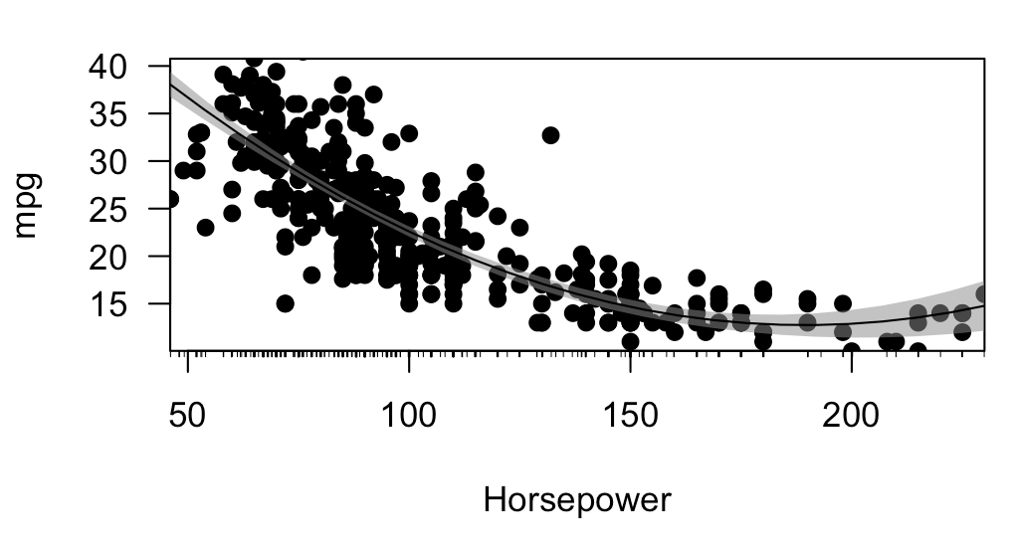
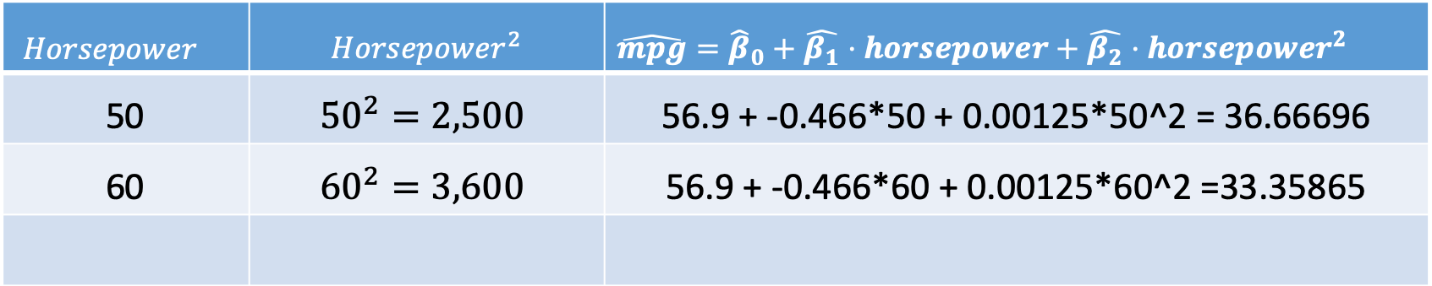
Nonlinear (Squared) Predictors
$$Horsepower^{}$$ | $$Horsepower^{2}$$ | $\hat{mpg}={\hat{β}}_{0}+\hat{β_{1}}⋅horsepower+\hat{β_{2}}⋅horsepower^{2}$
50 | $${50}^{2}=2,500$$ | 56.9 + -0.466*50 + 0.00125*50^2 = 36.66696
60 | $${60}^{2}=3,600$$ | 56.9 + -0.466*60 + 0.00125*60^2 =33.35865

Slide 25
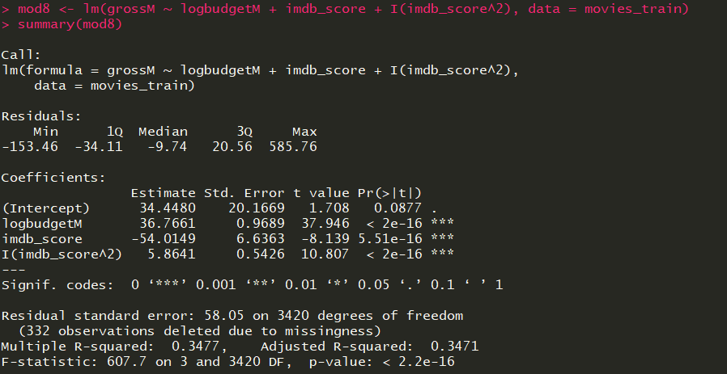
Squared X Terms (Feature Selection)

Slide 26
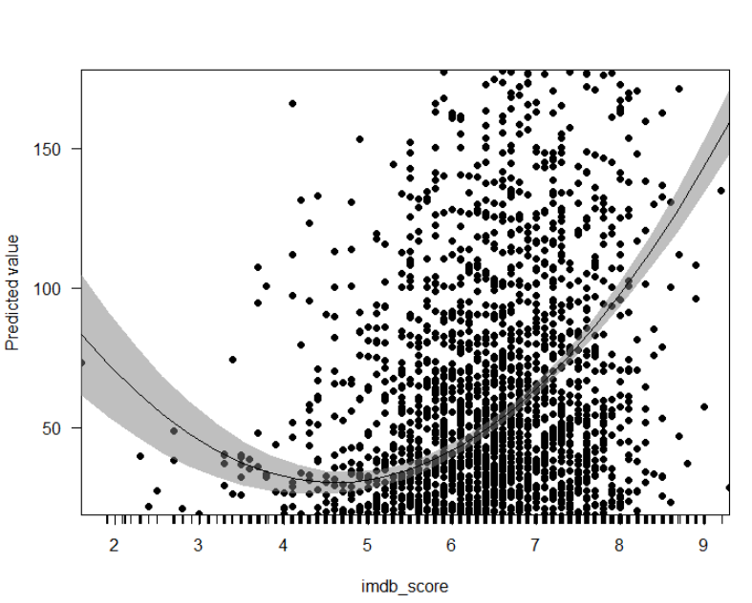
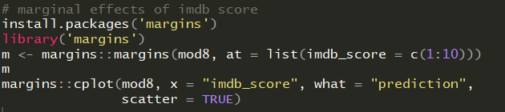
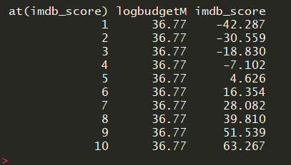
Interpreting Squared X Terms Using Margins Package

Slide 27
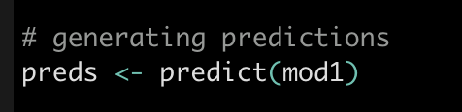
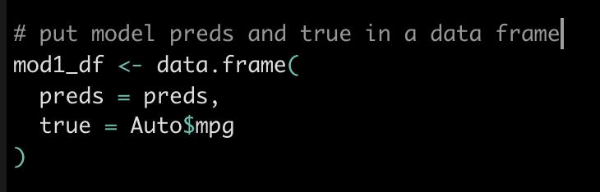
Generating Model Predictions

Slide 28
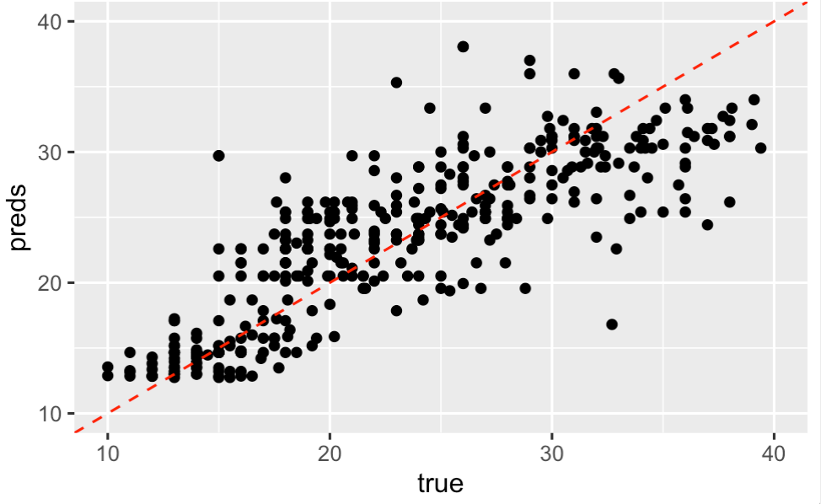
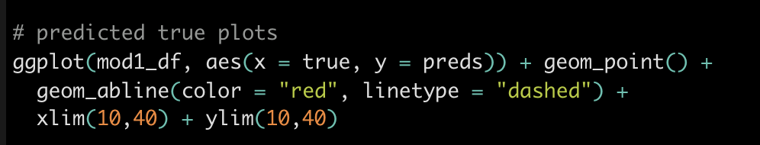
Predicted True Plots

Slide 29
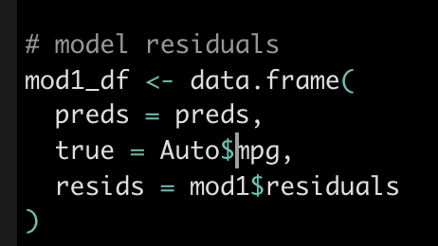
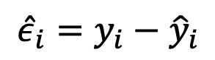
Residuals: mod1$residuals
$${\hat{ε}}_{i}=y_{i}−{\hat{y}}_{i}$$
$${\hat{ε}}_{i}=y_{i}−β_{0}−β_{1}⋅horsepower+β_{2}⋅horsepower^{2}$$

Slide 30
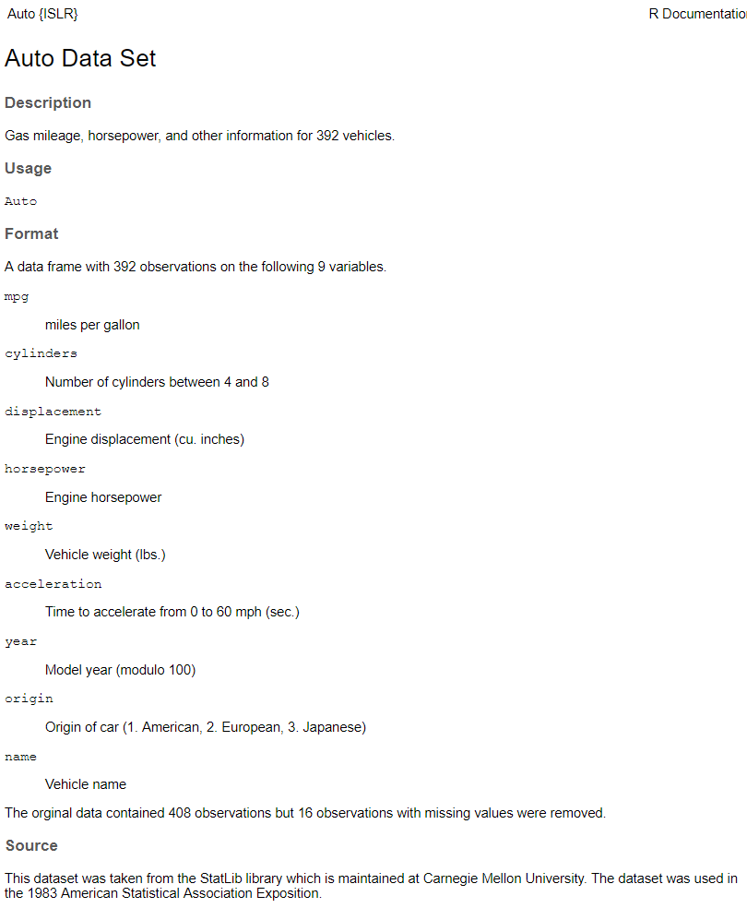
In Class Exercise
1. Install the ‘ISLR’ package and load the ‘Auto’ dataset (data(Auto))
2. Build your favorite model predicting mpg
3. Feel free to transform variables as you so desire
4. Produce various predicted/true plots (add your name as a title) and we can compare

Slide 31
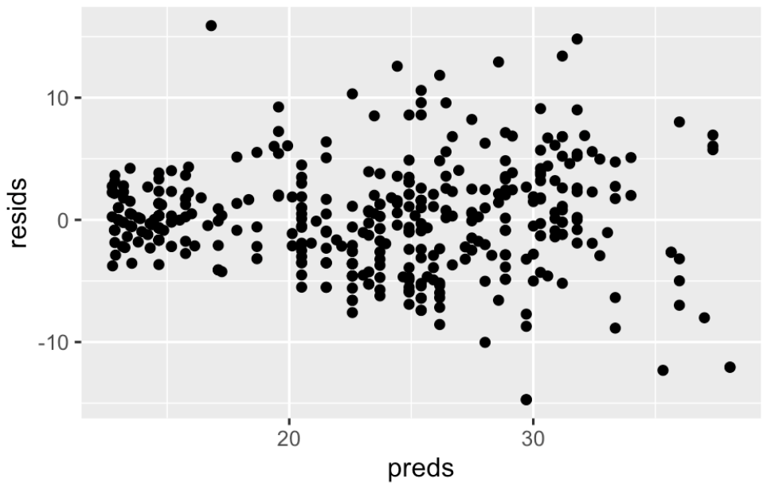
Plot of Residuals Against Fitted Values

Slide 32
Potential Problems with Regressions
Non-linearity of Xs
Non-constant variance of error term
Correlation of error terms
Outliers
High-leverage points
Collinearity
Correlation vs Causation

Slide 33
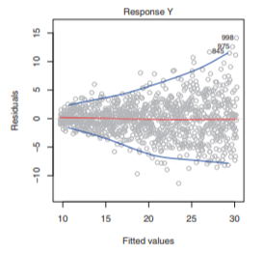
Heteroskedasticity: non-constant variance of errors

Slide 34
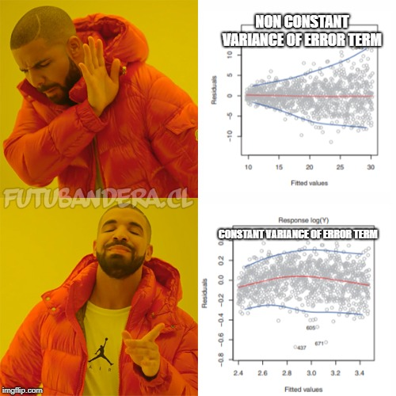

Slide 35
Do We Have Constant Error Variance?

Slide 36
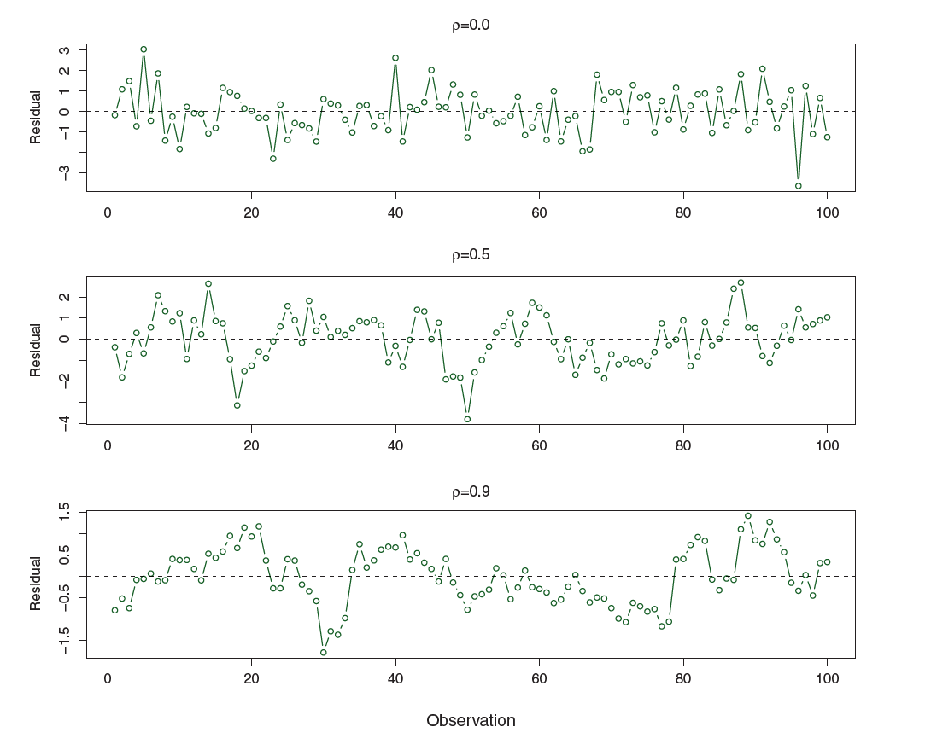
Correlation of Error Terms: Property of Time Series. Don’t worry about this

Slide 37
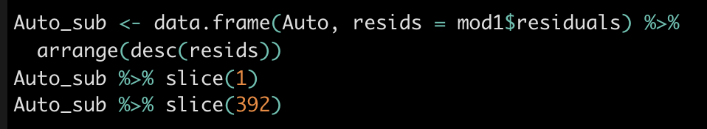
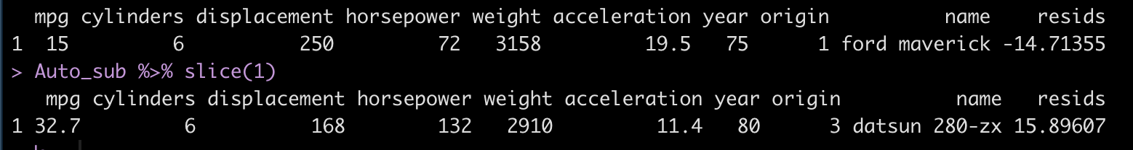
Outliers

Slide 38
Datsun (Nissan)
280ZX
Ford
Maverick
Why are these outliers?

Slide 39
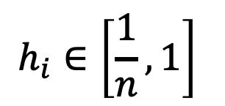
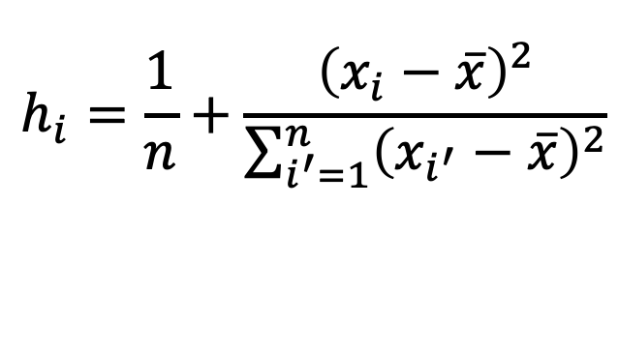
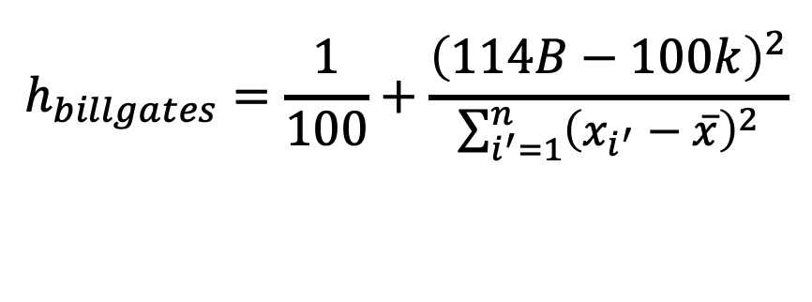


High Leverage Points
Leverage (aka hat value) of observation i: how much would all our predictions change if we exclude observation I
$$h_{i}=\frac{1}{n}+\frac{{\left(x_{i}−\overline{x}\right)}^{2}}{\sum_{i^{′}=1}^{n}{{\left(x_{i^{′}}−\overline{x}\right)}^{2}}}$$
$$e.g., x_{i}=jeff bezos net wealth,$$
$$n=100$$
$$h_{i}∈\left[\frac{1}{n},1\right]$$
$$h_{billgates}=\frac{1}{100}+\frac{{\left(114B−100k\right)}^{2}}{\sum_{i^{′}=1}^{n}{{\left(x_{i^{′}}−\overline{x}\right)}^{2}}}$$
$$Average=(p+1)/n$$

Slide 40

High Leverage Points in Auto

Slide 41

Plotting High Leverage Points Using plot(mod)

Slide 42

Collinearity

Slide 43

Impact of collinearity

Slide 44



Testing for collinearity: VIF (olsrr package)
$VIF\left({\hat{β}}_{j}\right)=\frac{1}{1−R_{X_{j}|X_{−j} }^{2}}$
Where $R_{X_{j}|X_{−j} }^{2}$ is the R^2 on all other predictors
VIF > 5 or 10 indicates problematic level of multicollinearity

Slide 45

Spurious Relationship?
Source: http://www.tylervigen.com/spurious-correlations

Slide 46

Spurious Relationship?
Source: http://www.tylervigen.com/spurious-correlations

